Slide 1
Couchbase
Erin Kelly, Molly Miller, Rashan Smith
CS 6381 Spring 2021 Final Project - Datastores

Slide 2
Overview
Couchbase is an open source, distributed, NoSQL document-oriented engagement database, optimized for interactive applications.
Couchbase is meant to help developers build quickly, scale big, and save more.

Slide 3
Couchbase Products
Couchbase Community Edition
Couchbase Enterprise Edition
Couchbase Cloud (DBaaS)

Slide 4
Features
Feature | Description
NoSQL | Data is stored in key-value object/item format, or JSON Object format. Unlike relational databases, there is no requirement to create a schema
N1QL ("nickel") | Declarative query language that extends SQL for JSON data. Combines familiarity of SQL with flexibility of JSON data model
Distribution | Automatically distributes data across all servers or virtual machines
Mem Cached Protocol Capability | Achieve Data Replication, Durability and Zero Application downtime when adding and removing servers
Durability | Ensures likelihood of data-writes surviving unexpected events such as node outages

Slide 5
Uses in Industry
Caching
Mobile data management
Session management
Mainframe offload
User profile store
Source-of-truth data stores
Operational dashboards
Device management
Mobile wallet
Pricing
Product catalog
Omnichannel
Personalization
Shopping cart
Recommendations

Slide 6
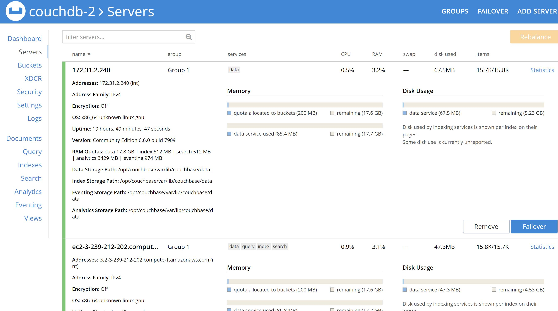
Technology Review
Feature | Description
Cloud Service | AWS
Setup | 1 Cluster, 2 Nodes
OS | Ubuntu, 8 CPU, 32 RAM

Slide 7
Hurdles
Chameleon issues
Couchbase installation issues
Lack of familiarity with Couchbase

Slide 8
Next Steps
Continue to become more familiar with Couchbase
Add another node
Continue working on experiments

